Slide 1
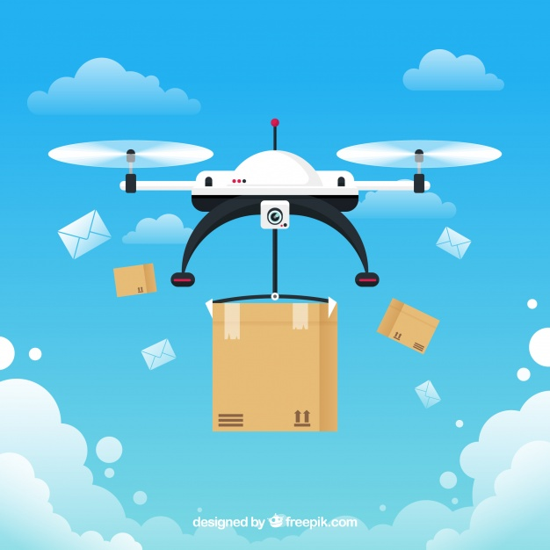
AIRWAYS COURIER SERVICES

Slide 2
TEAM EARTH
NAME- MAHESH KSHIRSAGAR
HEAD OF IT INFRASTRUCTURE DEPARTMENT
ASSIGNMENT TAKEN:
PLAN ON IT INFRASTRUCTURE
TITLE:
AIRWAY DELIVERY : A NEW BUSINESS OPPORTUNITY
PLAN ON IT INFRASTRUCTURE INCLUDING APPS, WEBSITES AND MANAGEMENT INFORMATION SYSTEMS.

Slide 3
Case understanding-
Courier service provider company
Business advancement
‘Hyper local delivery space'
Local delivery through drones
Received valuable feedback by initial users
“Short range drone based services"
End-to-end drone operations & management platform
Digitize service processes.

Slide 4
BCS solutions summary
Airway Delivery-
Apps, software and websites
Digital transformation or digitalization
Fundamental changes
Great impact on customer satisfaction ratings
Products delivered to be fast and efficient

Slide 5
Solutions-
We plan to implement the following it infrastructures:
Infrastructure-as-a-service (iaas)
Delivers fundamental compute, network, and storage resources to consumers on- demand
Platforms-as-a-service (paas)
Inflexibility of building and maintaining the platform on-premises.
It increases the speed of development

Slide 6
Hybrid cloud & multi-cloud
Running the organizations applications workload.
More effectively and cost-efficiently than could be with public or private cloud alone.
For storage- by using clouds the possibility of storing our files and accessing ,storing and retrieving them from any web-enabled interface.
At any time and any place
Stored in virtualized pools of storage hosted by customer specification requirements.
Drone fleet management software
It helps plan & execute short & long-range flights
Live tracking and drone control over 4G/LTE/5G.

Slide 7
Mobile field service tracking
Real-time tracking helps you control each task’s status
cancellations or delays occur
manage the changes and maintain a high level of service quality.
Service and experience management
Leverage the skills and tools needed to more effectively manage your cloud estate and drive new levels of employee experience.

Slide 8
Mobile workforce management software
manage tasks and satisfy customers
providing information and controlling the service
ensure high-quality customer experience
Mobile workforce management app-
enables technicians to access work order data
access work order data
creating completion reports

Slide 9
Service desk
Available 24/7,
service desk is a multichannel
finding - and solving - root causes of any issues
delivering the right support and top customer experience.
Smart field management app
managing and planning service visits
integrated with POs and ERP

Slide 10
Avoid situations which lead to customer dissatisfaction
Communicate effectively by sending notifications or text messages of the current status of the issue, including details of when a technician should arrive.
Automated messages can provide a solution to challenges faced when implementing field service management in retail.
Mobile app available for customers, so they can change visit dates and times should they wish.

Slide 11
Airway delivery-
Optimization of hardwares and softwares
High availability, speed , scalability and security
90% of delivery type of service in given time
Decreasing our mean service time
Mobile app enables managers and dispatchers to control the quality of the technicians’ work
Access to a broad set of options and tools

